Slide 1


Local Government Reorganisation
in East Sussex

Slide 2
Welcome

Slide 3
Today’s agenda
  Introductions
  Local Government Reorganisation Process
  Impact on staff
  One East Sussex Proposal
  Other bids
  Questions/answers
  Next steps

Slide 4

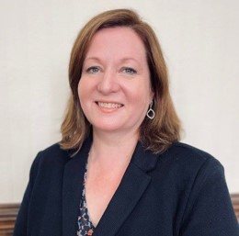

Your Chief Executives
Rob Cottrill
Chief Executive of Eastbourne Borough Council and Lewes District Council, and Interim Chief Executive of Hastings Borough Council
Lorna Ford
Chief Executive of Rother District Council
Becky Shaw
Chief Executive of East Sussex County Council

Slide 5
LGR process
Dec 2024: Government decides all two-tier areas will become unitary - replacing current county councils and district and borough councils.
Proposals for new unitary councils (with populations of at least 500,000) to:
  achieve efficiencies
  improve capacity
  withstand financial shocks
  enable strong community connections
  enable wider public service reform.
Feb 2025: East Sussex announced in fast track (Devolution Priority Programme)
March 2025: Interim Plan submitted by all six East Sussex councils
Summer 2025: One East Sussex Proposal developed, costed and consulted on. Very strong public support to create a new unitary council on existing boundaries
Two further models developed in Hastings.
Sept 2025: One East Sussex proposal submitted to Government by five Councils (Wealden decided not to express a preference for any model)
Nov – Jan 2026: Statutory consultation underway

Slide 6
Impact on staff
  No reduction in services councils expected to deliver at either tier
  Skilled and dedicated workforce needed through transition and beyond
  Continuing Authority approach and TUPE (Transfer of Undertakings (Protection of Employment)) and other employment protections remain in place
  We will learn from others’ experiences, which suggest it will take a further 2-3 years after ‘go live’ for the new organisation to bring new teams together and harmonise terms and conditions
  We will work closely with staff of all councils as we create the new structures

Slide 7
One East Sussex - principles
The Leaders agreed a set of principles for the work, the key ones for staff include:
  We are creating a new council drawing on our strong partnerships
  Supporting staff in all councils is crucial to delivery during transition and beyond and a comprehensive workforce plan to provide maximum stability is a priority
  This is a joint endeavour in which all Councils have a shared ambition to work collaboratively to co-design the new unitary authority, whilst acknowledging and respecting the corporate roles, responsibilities and risks of the current authorities
  We will be evidence led
  We will learn from others’ experiences of Local Government Reorganisation

Slide 8
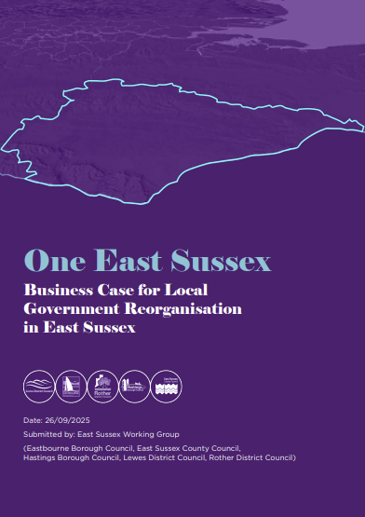
One East Sussex
Is underpinned by a robust evidence base, including sign-off of the financial data by S151s.
Takes account of resident and stakeholder feedback.
Aligns with existing service delivery and partnership footprints (e.g. housing, social care, education, public health).
Minimises disruption to statutory services and partnerships.
Builds on established collaboration across the six councils.
Meets the government’s population guidance and maintains a coherent geographic identity.
Creates operational savings and avoids the substantial costs of disaggregation.
Worked up by the six councils, involving cross-party collaboration to reach agreement on the strongest proposal for the area.
Meets all six Government criteria for LGR.

Slide 9

What have residents, businesses and partners told us?
  Strong support for reorganising on the current East Sussex footprint and near-universal opposition to sharing new council structures with the city of Brighton & Hove (BHCC). In areas of Lewes district where BHCC suggested it might expand, almost nine in 10 people (89 per cent) rejected the idea.
  High-quality services was the most important thing people wanted to see from a new council. In a county-wide survey, six in 10 people named this as a priority
  Almost three-quarters of people (74 per cent) in the same survey felt the single unitary was the only model that should be proposed to government. Cost-saving was named as the single biggest benefit.
  Concern about a potential loss of local representation under a single unitary council.

Slide 10
Opportunities
Improved customer outcomes and value for money for residents through integrated services. A single authority can take a holistic view of need and design services accordingly through whole-system planning and delivery.
Financial savings through consolidation of back-office functions, rationalisation of assets, and streamlined governance. The One East Sussex model offers the greatest value for money by avoiding the high disaggregation costs and duplication associated with alternative models, delivering a forecast net benefit of £25 million by 2032/33 through consolidation, transformation, and increased income.
Enhanced Service Resilience: A larger council improves capacity to manage risks.
Economic Growth and Investment: A single council provides a stronger voice to attract investment and promote regional economic development. An integrated approach to the use of of digital and technological innovation will facilitate service delivery that better reflects how residents live their lives and how businesses operate, generating more economic prosperity.
Local Voice and Community Engagement: Maintaining strong local communities and digital access ensures that local voices shape council decisions. A unified East Sussex will have greater influence in regional and national decision-making and be better placed to shape policy and represent the interests of its residents.

Slide 11
Risks and concerns
Resource and capacity for implementation
Funding deficits/effect of funding reforms
Managing changes for staff
Perceived uncertainty for service users
Perception of services being less local
Increase in workload for Councillors

Slide 12
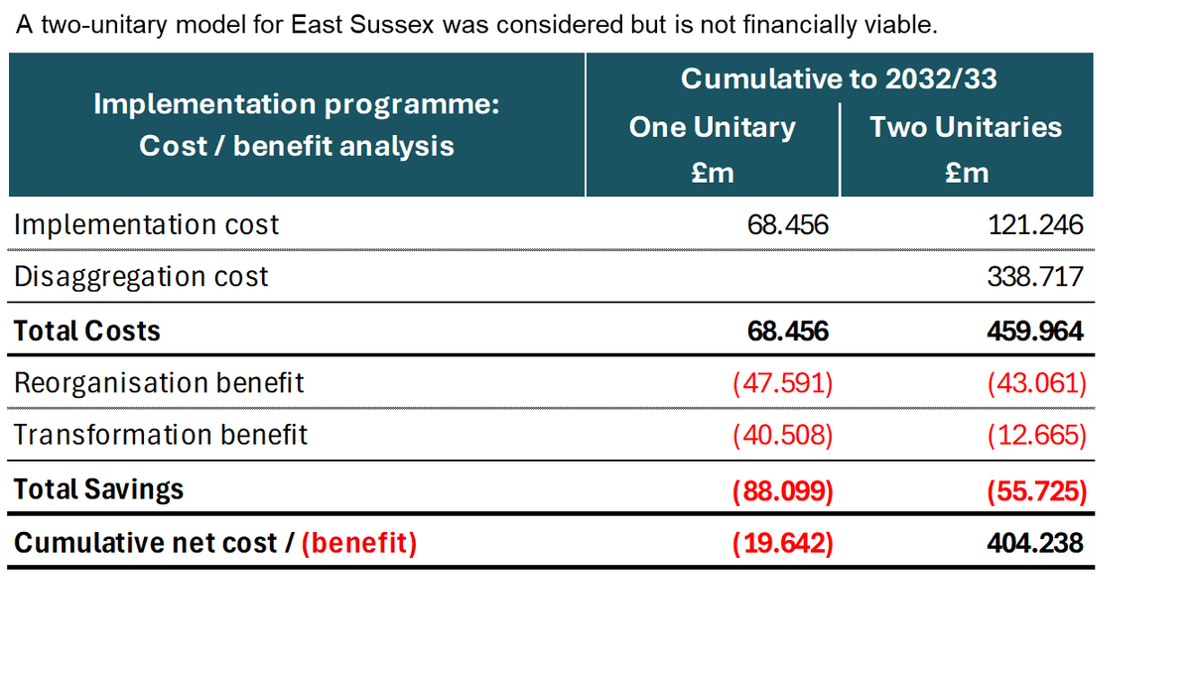
Alternative models considered...
A two-unitary model for East Sussex was considered but is not financially viable.

Slide 13
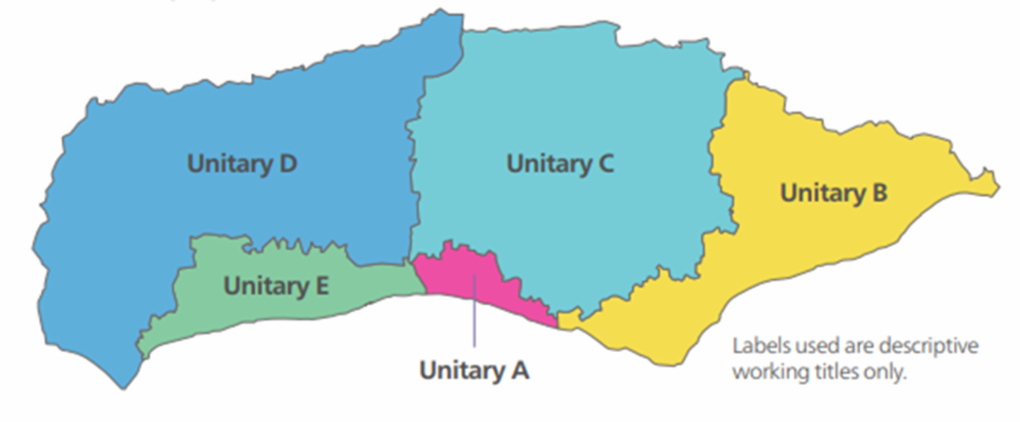
Brighton & Hove City Council’s proposal
“Representative Councils for a Devolved Sussex: A Five-Unitary Model”

Slide 14
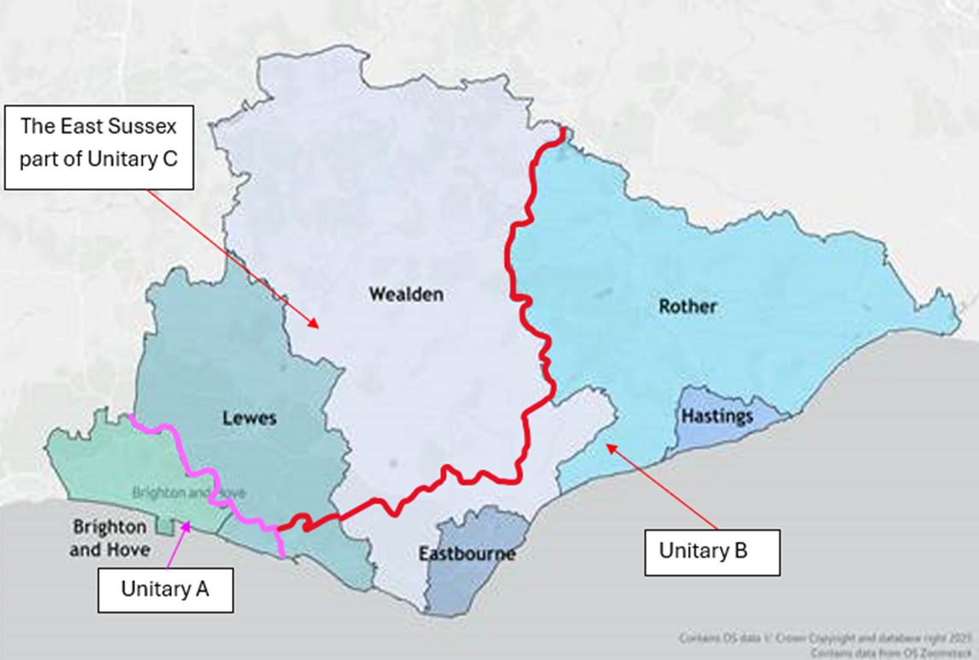
Brighton & Hove City Council’s proposal - East Sussex
Concerns:
  Challenges in maintaining effective community services
  Uncertainties in cost savings and assumptions about funding allocations
  High level of splitting and merging existing councils
  Financial disparities and variation in need across five unitaries
  Population size for viability not met
  Inadequate planning for transition costs
  Insufficient engagement, consultation and strong local opposition

Slide 15
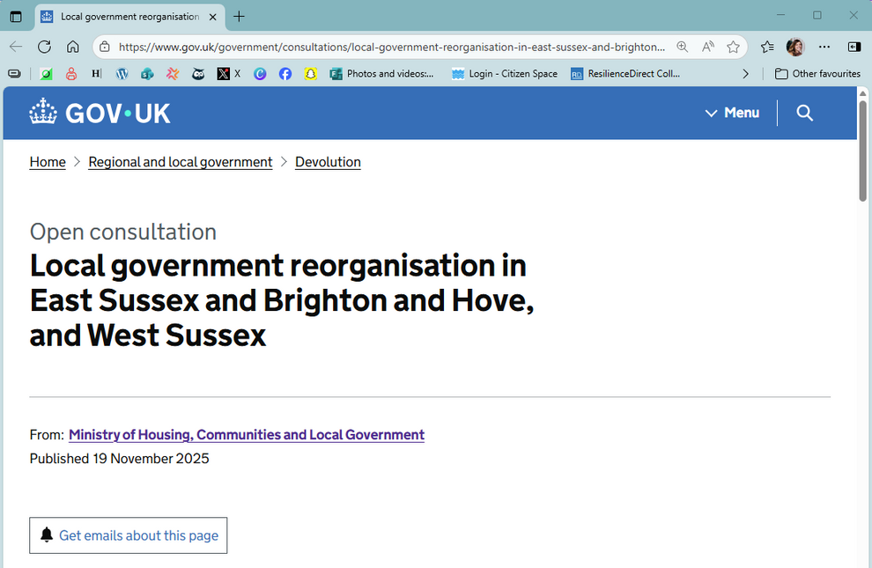

One East Sussex - the exemplar
  Builds on strong relationships and experience
  Provides sensible and ambitious evolution to an efficient new council
  Greater clarity and seamless customer service for residents and businesses
  Confidence in delivery of new model
  Opportunities for staff
Local government reorganisation in East Sussex and Brighton and Hove, and West Sussex - GOV.UK

Slide 16
What you can expect from senior management
  Clear leadership, from officer and political leaders
  Positivity and purpose
  Programme management of the process, including learning from other areas
  Open communication – sharing what we can when we can and listening to and involving staff
  Seeking to put you in the best possible position for the future

Slide 17
Questions & answers

Slide 18
Next steps
  Now until 11 January – statutory consultation
  End Feb/March 2026 – Government expected to decide on unitary government for East Sussex
  May 2026 – start of Sussex and Brighton Combined County Authority
  May 2027 – expected election of councillors to ESCC as continuing authority to prepare for unitary council
  April 2028 – start of new unitary authority (vesting day)
  May 2028 (tbc) – election of Mayor for Sussex

